Slide 1
PHISHING WEBSITE DETECTION
Using deep learning
SUBMITTED BY:
BHARATHRAJ R
513121104703
THANTHAI PERIYAR GOVERNMENT INSTITUE OF TECHNOLOGY ,VELLORE.

Slide 2
AGENDA:
Problem statement
Proposed solution
Algorithm and development
Result
Conclusion
References

Slide 3
PROBLEM STATEMENT
Description: The problem centers around the identification of phishing websites, which are malicious sites aimed at deceiving users and stealing sensitive information.
Challenges: Detecting these malicious phishing websites manually is challenging due to their dynamic nature, evolving tactics, and the sheer volume of URLs circulating on the internet.
Objective: The objective is to create a Deep learning model that accurately distinguishes between phishing and legitimate websites based on URL features.

Slide 4
PROPOSED SOLUTION
Description: The proposed solution employs an MLP (Multi-Layer Perceptron) Classifier, a type of deep learning model, for classifying URLs as either phishing or legitimate.
Data Preprocessing: Implement robust data preprocessing steps, including handling missing values, scaling features, and encoding target variables, to ensure data quality and compatibility with the MLP classifier.
Model Training: Train the MLP classifier using a portion of the dataset, optimizing hyperparameters such as hidden layer sizes, batch size, and early stopping to enhance model performance and prevent overfitting.
Advantages: MLPs excel in learning intricate patterns within data and are well-suited for classification tasks.

Slide 5
ALGORITHM AND DEVELOPMENT
Loading the Dataset: The program begins by loading the dataset 'phishing_website.csv,' which contains URL-related features and their corresponding phishing status.
Preprocessing the Data: Data preprocessing encompasses handling missing values using Simple Imputer, standardizing the data with StandardScaler, and encoding the target variable using Label Encoder.
Model Training: An MLP Classifier is trained with specified parameters such as hidden layer sizes, maximum iterations, batch size, and early stopping to prevent overfitting.
Evaluation: The model's accuracy on the test set is computed to evaluate its efficacy in identifying phishing URLs.

Slide 6
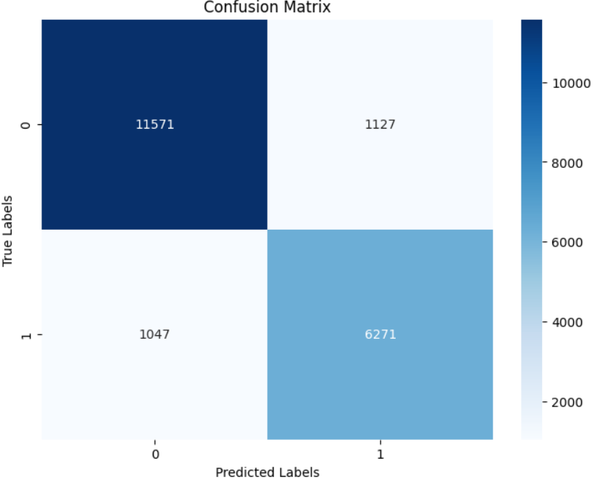
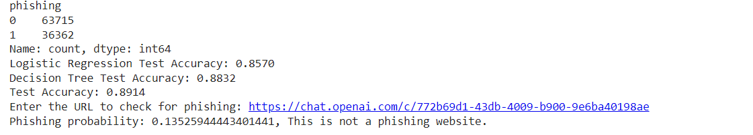
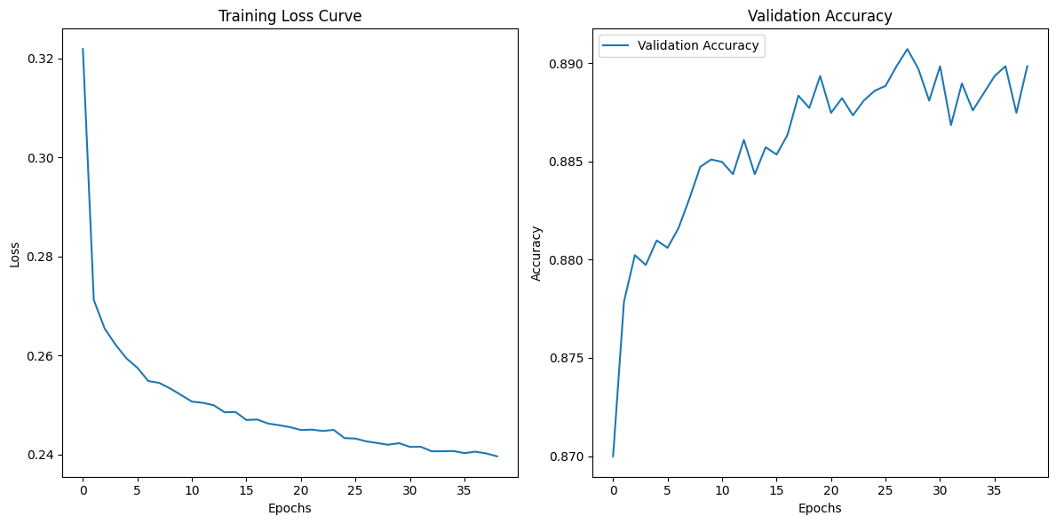
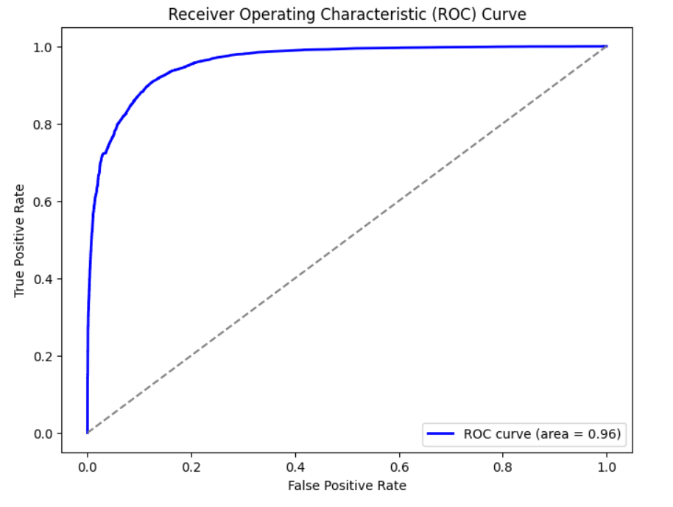
RESULT

Slide 7
CONCLUSION
Effectiveness of the Model: The presentation concludes by summarizing the effectiveness of using an MLP classifier for detecting phishing websites, highlighting its potential in bolstering cybersecurity measures.
Potential Applications: It discusses potential real-world applications of deploying such models in cybersecurity frameworks to enhance threat detection and prevention.

Slide 8
REFERENCES
https://www.python.org/
https://www.tensorflow.org/
https://keras.io/
https://numpy.org/
https://matplotlib.org/
https://scikit-learn.org/
https://docs.python.org/3/library/urllib.parse.html
https://scikit-learn.org/stable/modules/generated/sklearn.impute.SimpleImputer.html
https://scikit-learn.org/stable/modules/classes.html#module-sklearn.preprocessing

